Slide 1



UNIVERSITY INSTITUTE OF ENGINEERING
COMPUTER SCIENCE ENGINEERING
Bachelor of Engineering
Cloud Computing(CST-411)
Prepared By: Ms. Himanshu(E11818)
Topic: Virtualization
DISCOVER . LEARN . EMPOWER

Slide 2
Learning Objectives & Outcomes
Objective:
To understand the concept of Virtualization
Outcome:
Student will understand
Virtualization
Its types

Slide 3
Overview
Meaning of Virtualization
What is the concept behind the Virtualization
Architecture of Virtualization
Types of Virtualization
Cloud Vs Virtualization
Advantages of Virtualization
Disadvantages of Virtualization

Slide 4

Virtualization

Slide 5
Introduction Of Virtualization
Virtualization is a technique, which allows to share single physical instance of an application or resource among multiple organizations or tenants (customers)..
Virtualization is a proved technology that makes it possible to run multiple operating system and applications on the same server at same time.
Virtualization is the process of creating a logical(virtual) version of a server operating system, a storage device, or network services.
The technology that work behind virtualization is known as a virtual machine monitor(VM), or virtual manager which separates compute environments from the actual physical infrastructure.

Slide 6
What is the Concept behind the Virtualization
Creation of a virtual machine over existing operating system and hardware.
Host machine: The machine on which the virtual machine is created.
Guest machine: virtual machines referred as a guest machine.
Hypervisor: Hypervisor is a firmware or low-level program that acts as a Virtual Machine Manager.

Slide 7

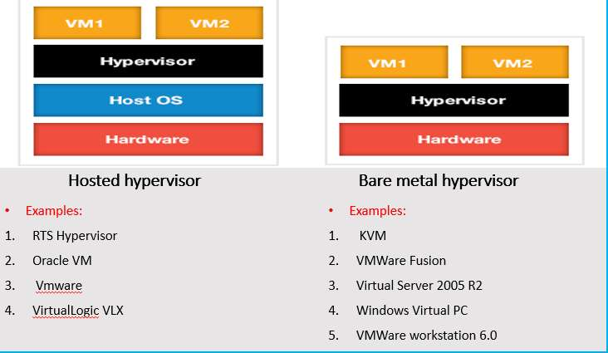
Architecture Of Virtualization

Slide 8
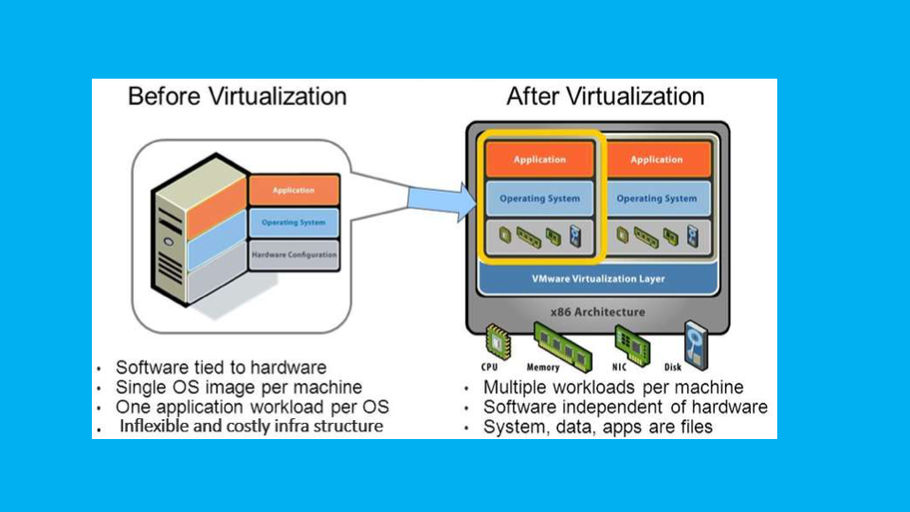

Slide 9
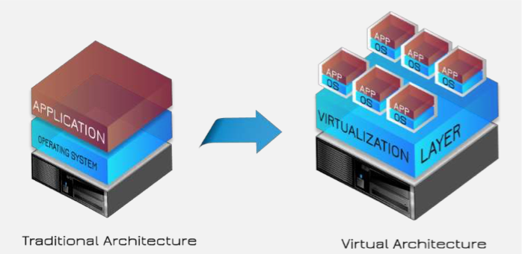

Slide 10

Types of Virtualization
Hardware Virtualization.
Operating system Virtualization.
Server Virtualization.
Storage Virtualization.

Slide 11
Hardware Virtualization
When the virtual machine software or virtual machine manager (VMM) is directly installed on the hardware system is known as hardware virtualization.
The main job of hypervisor is to control and monitoring the processor, memory and other hardware resources.
Usage:
Hardware virtualization is mainly done for the server
platforms, because controlling virtual machines is much
easier than controlling a physical server.

Slide 12

Operating System Virtualization
When the virtual machine software or virtual machine manager (VMM) is installed on the Host operating system instead of directly on the hardware system is known as operating system virtualization.
Usage:
Operating System Virtualization is mainly used for testing
the applications on different platforms of OS.

Slide 13
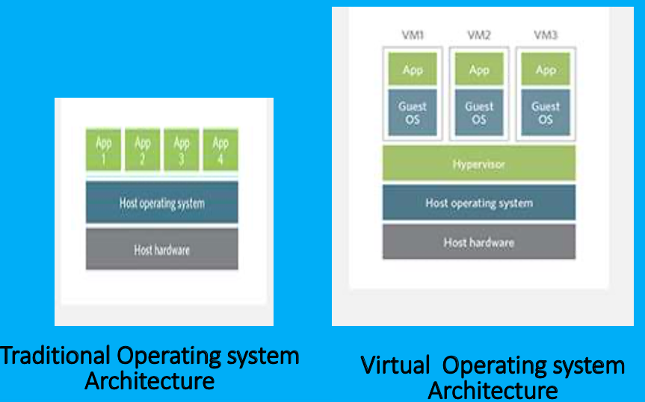

Slide 14
Server Virtualization
When the virtual machine software or virtual machine manager (VMM) is directly installed on the Server system is known as server virtualization.
Usage:
Server virtualization is done because a single physical
server can be divided into multiple servers on the
demand basis and for balancing the load.

Slide 15
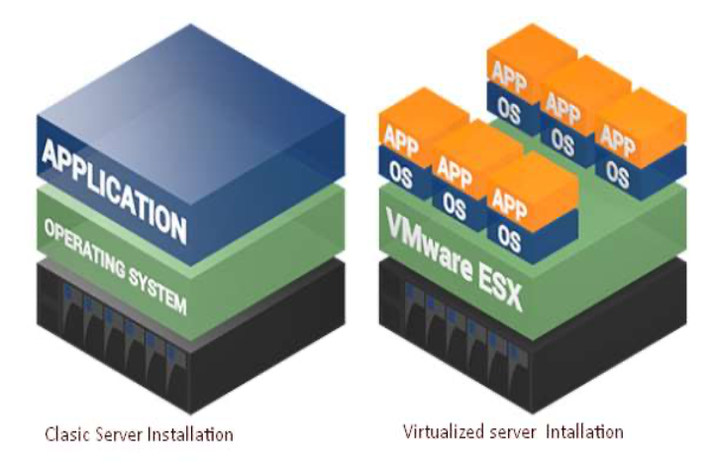

Slide 16
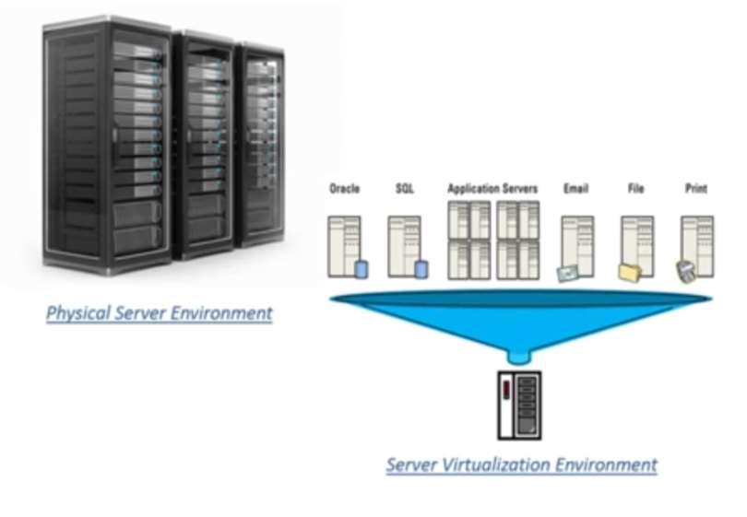

Slide 17
Storage Virtualization
Storage virtualization is the process of grouping the physical storage from multiple network storage devices so that it looks like a single storage device.
Storage virtualization is also implemented by using software applications.
Usage:
Storage virtualization is mainly done for back-up and
recovery purposes.

Slide 18
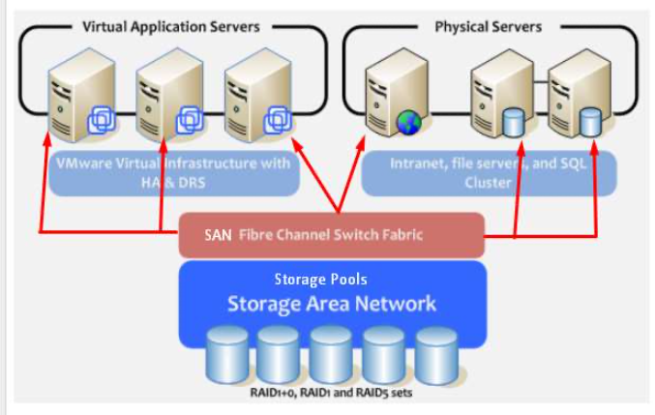

Slide 19

Cloud vs Virtualization
Cloud computer is internet based computing where virtual shared provide Software, Infrastructure, platform.
Virtualized
API
Pay-as-per-use
Scalability
Virtualization can exist without the cloud but cloud computing cannot exist without virtualization.

Slide 20

Advantages of Virtualization
Reduced Costs.
Efficient hardware Utilization.
Virtualization leads to better resource Utilization and increase performance
Testing for software development.
Increase Availability
Save energy
Shifting all your Local Infrastructure to Cloud in a day
Possibility to Divide Services
Running application not supported by the host.

Slide 21

Disadvantages of Virtualization
Extra Costs.
Software Licensing.

